Slide 1
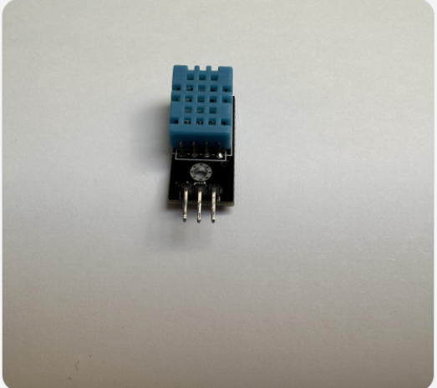
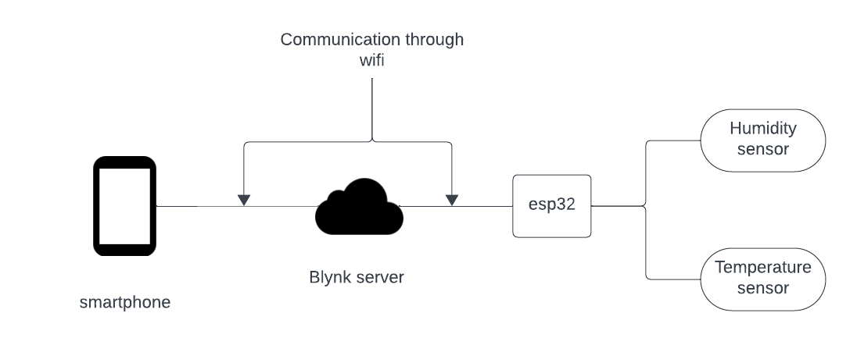

Clothes Dryer Sensor
Sensor:
Improve quality of life when drying clothes.
Provide data to the user on their drying.
Project Overview :
Improve quality of life when drying clothes.
Provide data to the user on their drying.
Experiments:
Run multiple tests to see the optimal point in clothes becoming dry - the measurements of the humidity and temperature
Actuation:
Main aim – Send a notification to user on their smartphone when clothes are ready to be taken down, using Blynk
Future Implementations:
Predict the time it should take for the clothes to dry.
Use on more specialist equipment – Wetsuits, wet-shoes etc.
Problems:
External influences affecting the temperature, will change depending on location of clothesline.

